Slide 1
MACHINE LEARNING
B. SIVANANDU
Y22CM017

Slide 2
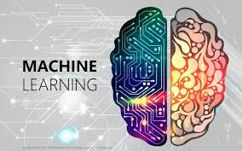
Agenda
INTRODUCTION
Types of ml
Supervised ml
Unsupervised ml
Reinforcement learning
project

Slide 3
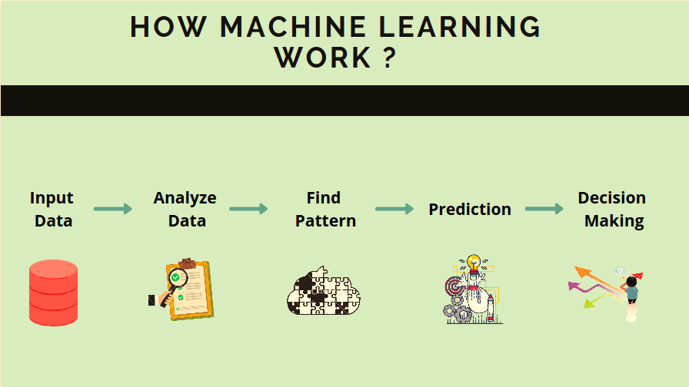
MACHINE LEARNING
Machine learning is a branch of artificial intelligence that enables computers to learn from data and improve their performance on tasks without being explicitly programmed. By analyzing patterns in data, machine learning models can make predictions or decisions based on new inputs.

Slide 4
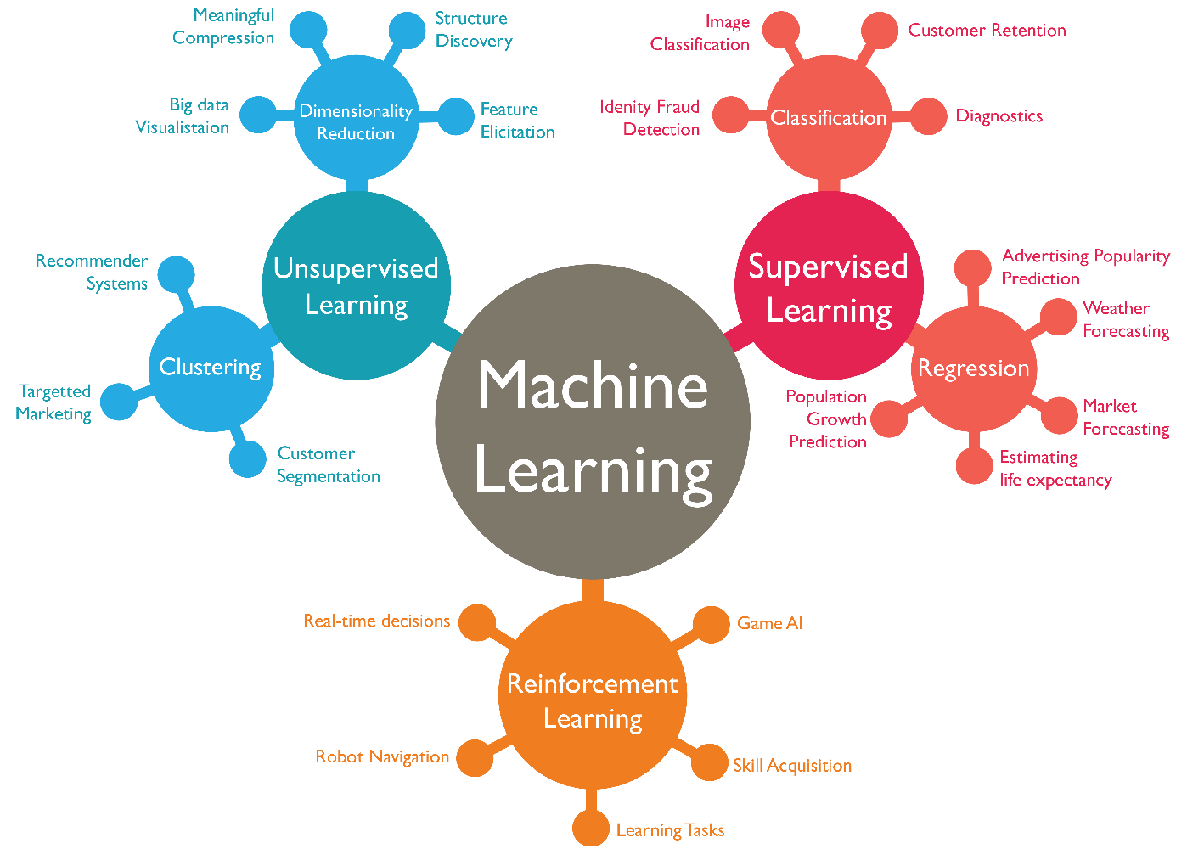
Types of Machine learning
Based on the nature of learning process and the type of feedback they receive from the environment “MACHINE LEARNING” can be mainly divided into three types :
Supervised Learning
Unsupervised Learning
Reinforcement Learning

Slide 5
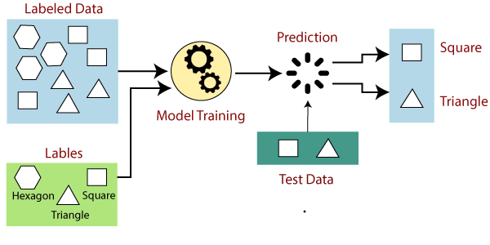
Supervised Learning
The Supervised Learning is the type of Machine learning in which machines are trained using well labelled data and on the basis of data the machines predict the output
Supervised Learning
Regression
Classification

Slide 6
Regression
Regression algorithms are used if there is a relationship between input variable and output variable.
These are classified into 5 types
→Linear regression
→Regression trees
→Non linear regression
→Bayesian regression
→Polynomial regression
These are used to prediction of continuous variables like weather forecast ,market trend etc
Classification
Classification is used when the output is categorical ,which means there are two classes such as male- female , true-false etc.
These are classified into 4 types
→Random Forest
→Decision Trees
→Logistic Regression
→Support vector Machines
These are mainly used in Spam detection, medical diagnosis, Image recognition etc

Slide 7
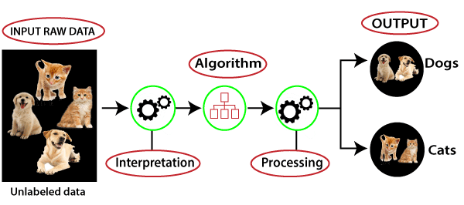
Unsupervised Learning
The Unsupervised learning is a type of machine learning where the model is trained on unlabeled data, meaning there are no predefined outputs. The goal is to discover hidden patterns or intrinsic structures in the input data.
Unsupervised Learning
Clustering
Association

Slide 8
Clustering
Clustering groups similar data points into clusters based on features, helping identify patterns in unlabeled data.
These are classified into 5 types :
→K-Means Clustering
→Hierarchical Clustering
→DBSCAN
→Mean Shift Clustering
→Gaussian Mixture Models (GMM)
These are used in customer segmentation and image segmentation, as well as anomaly detection and market research.
Association
Association algorithms discover relationships and patterns among large datasets, identifying item co-occurrences.
These are classified into 3 types:
→Apriori Algorithm
→Eclat Algorithm
→FP-Growth
Commonly applied in market basket analysis and recommender systems, as well as web usage mining and intrusion detection.

Slide 9
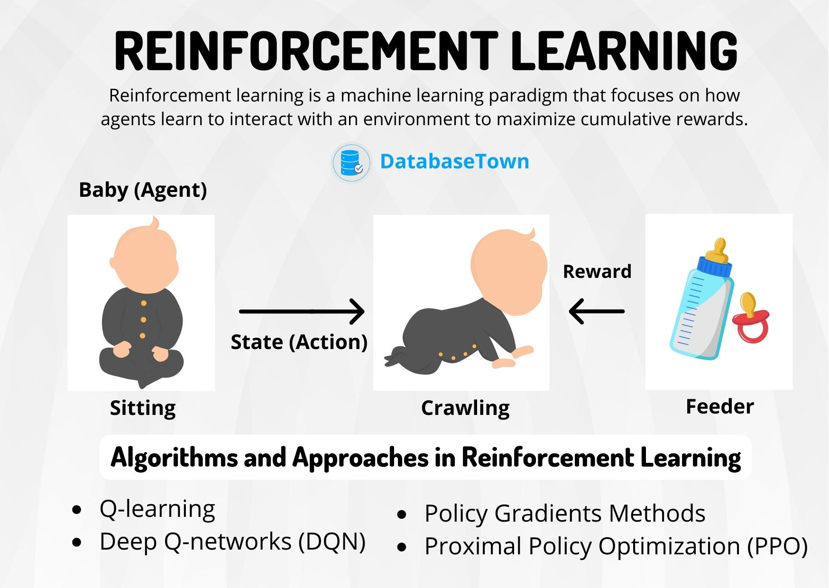

Slide 10
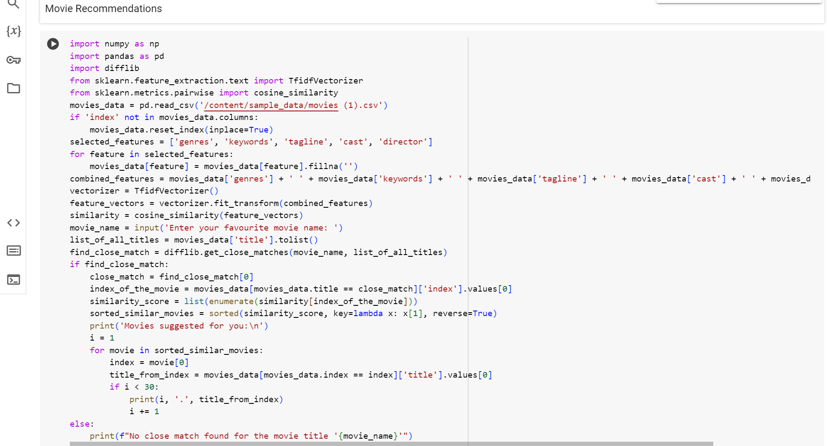
MOVIE RECOMMENDATIONS USING MACHINE LEARNING

